Slide 1

Wiki-data analysis
Conor Sosh

Slide 2
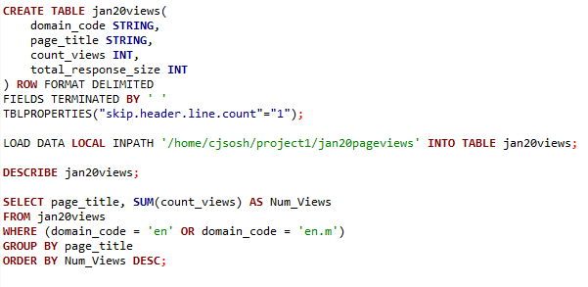
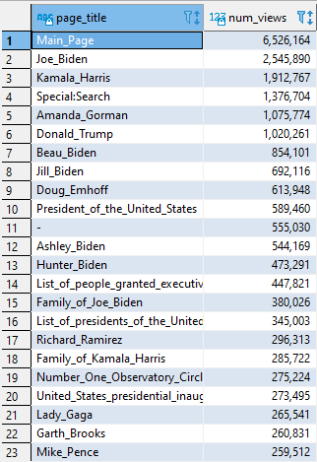
Which English Wikipedia article got the most traffic on January 20th, 2021?
Table creation & Query
Results

Slide 3
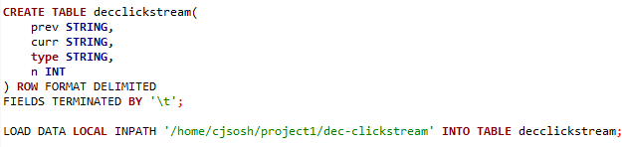
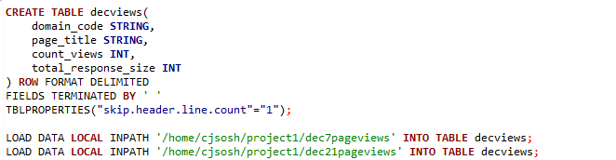
What English Wikipedia article has the *largest fraction* of its readers follow an internal link to another Wikipedia article?
Setup of the clickstream
Used data from December 2020
Setup of the page views table
Used data from two full days from December 2020

Slide 4
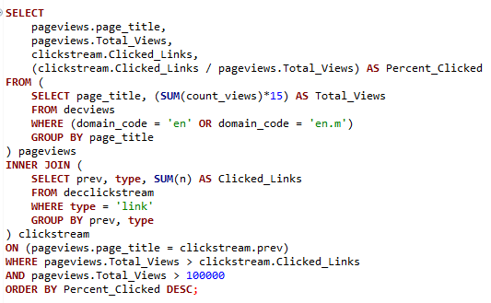
Q2 Continued
Two different locations for information: page views & click stream
Requires a join on the tables
Sum of count views extrapolated out to a full month
Two restrictions on Total_Views:
Must be greater than Clicked_Links
Must be greater than 100,000

Slide 5
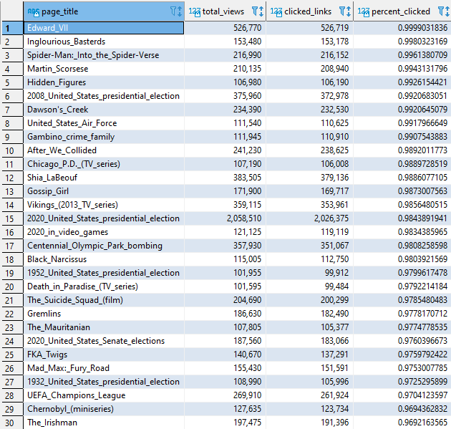
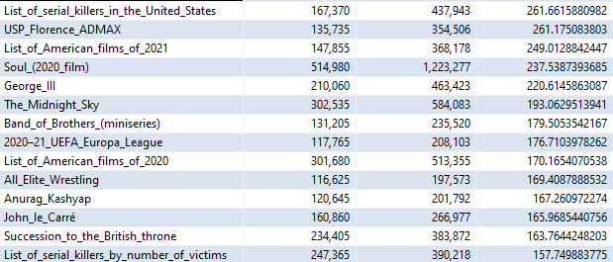
Q2 Results
Edward the Seventh keeps the most people in Wikipedia
(Given our restrictions)
Sample of results without restrictions:

Slide 6


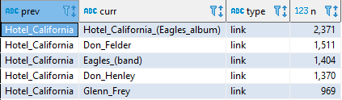
What series of Wikipedia articles, starting with Hotel California, keeps the largest fraction of its readers clicking on internal links?
Result: 61,845 views
2,371 / 61,845 go to the Eagles Album

Slide 7


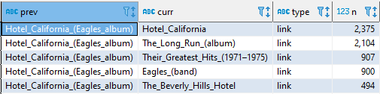
Q3 Continued
Result: 34,305 views
Uh oh, choosing that top link would loop us back to Hotel California…
We’ll go with the second link instead: 2,104 / 34,305 people go there.

Slide 8


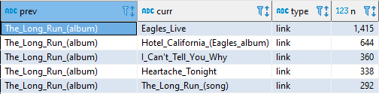
Q3 Continued
Result: 12,480 views
1,415 / 12,480 go to Eagles Live

Slide 9



Q3 Final
Result: 5,220 views
2,113 / 5,220 people click a link

Slide 10
Q3 Results
(2,371 / 61,845) * (2,104 / 34,305) * (1,415 / 12,480) * (2,113 / 5,220) ~ = 0.0180%
Hotel California → Eagles Album → The Long Run → Eagles Live

Slide 11
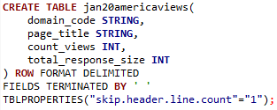
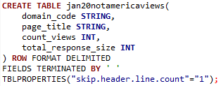
Find an example of an English Wikipedia article that is relatively more popular in the Americas than elsewhere.
The secret is in the data we load into these tables
This box contains data from Noon to 5pm EST on January 20th
This box contains data from 7AM to Noon EST on January 20th
(And we assume more people use the internet in the afternoon)

Slide 12
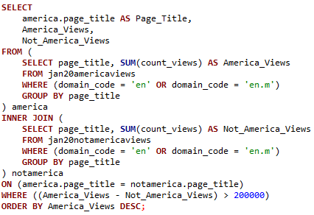
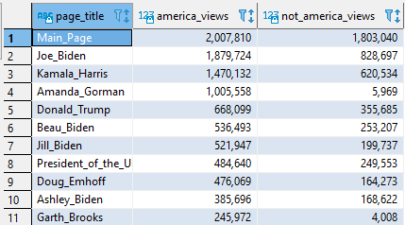
Q4 Results
Important thing to note:
We filter results to have a difference larger than 200,000

Slide 13

Analyze how many users will see the average vandalized Wikipedia page before the offending edit is reversed
Result: 1.5929 Days to revert vandalism
Result: Every article is *viewed* by 1.807 people. (We’ll go ahead and round that up to 2)

Slide 14
Q5 Results
1.5929 Days to revert vandalism * 1.807 people viewing an article per day = 2.878
~= 3 people view a vandalized article per day
In a future calculation, I would likely take an average from the clickstream, or filter the page views table to only include articles with > 100,000 views.

Slide 15
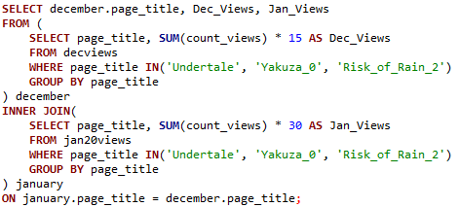

Run an analysis you find interesting: Comparing page views of various games
Actually rather surprising to me, since the Yakuza series was a much more high quality game, an established franchise, and had much more traffic from streamers/content creators, but was totally blown out of the water by Undertale.

Slide 16
GitHub Repo: https://github.com/HomelessSkittle/CJS-Wiki-Analysis

